Slide 1
Using keys for everything*
*except finding your car keys

Slide 2
Keys are the key…
To finding stuff when you want to link to or reuse it.
To quickly finding and fixing broken external links.
To changing file characteristics like the file name, file type, navtitle, or metadata.
To maintaining changeable terms so that you don’t get hosed every time those pesky marketing people (or, in extremely rare cases, you) decide to change the name of a product, feature, term, etc.

Slide 3
What I will show today
A DITA map with
  Submaps
  Topics (concepts, tasks, reference, and glossterm)
  Graphics
  Bitmaps
  Internal and external links
A DITA key map with key definitions for all of the above
OOTB oXygen responsive webhelp output

Slide 4
The main map
<?xml version="1.0" encoding="UTF-8"?>
<!DOCTYPE map PUBLIC "-//OASIS//DTD DITA Map//EN" "map.dtd">
<map>
<title>My Application User Guide</title>
<mapref keyref="submap_requirements"/>
<mapref keyref="submap_sites"/>
<mapref keyref="submap_rules"/>
<mapref href="keys_myApp.ditamap" toc="no"/>
<mapref href="keys_myApp2.ditamap" toc="no"/>
</map>
3 submaps
}
}
2 keymaps

Slide 5
The keymap
<map>
<title>Keys for My App</title>
<!--submap keys-->
<keydef keys="submap_requirements" href="requirements.ditamap" format="ditamap"/>
<keydef keys="submap_sites" href="sites.ditamap" format="ditamap"/>
<keydef keys="submap_rules" href="rules.ditamap" format="ditamap"/>
<!--topic keys-->
<keydef keys="topic_platforms_supported" href="c_supportedPlatforms.dita"/>
<keydef keys="topic_languages_supported" href="c_supportedLanguages.dita"/>
<keydef keys="topic_pageTagging" href="c_pageTagging.dita"/>
<keydef keys="topic_rule_defined" href="c_whatIsARule.dita"/>
<keydef keys="topic_rule_create" href="t_createRule.dita"/>
<keydef keys="topic_rule_delete" href="t_deleteRule.dita"/>
<keydef keys="topic_site_defined" href="c_site.dita"/>
<keydef keys="topic_site_create" href="t_createSite.dita"/>
<keydef keys="topic_site_delete" href="t_deleteSite.dita"/>
<keydef keys="imageList" href="imageList.dita"/>
<keydef keys="fieldList" href="fieldList.dita"/>
<!--glossary keys-->
<keydef keys="gloss_clientSideCondition" href="glossClientSideCondition.dita" type="glossentry"/>
<keydef keys="gloss_serverSideCondition" href="glossServerSideCondition.dita"/>
<!--external links-->
<keydef keys="dilbert" href="http://www.dilbert.com" format="html" scope="external"
navtitle="dilbert.com"/>
<!--product name keys-->
<keydef keys="prodname_myApp_full">
<topicmeta>
<keywords>
<keyword>My Application</keyword>
</keywords>
</topicmeta>
</keydef>
<keydef keys="prodname_myApp_short">
<topicmeta>
<keywords>
<keyword>myApp</keyword>
</keywords>
</topicmeta>
</keydef>
<!--images-->
<keydef keys="picture_screen_sites" href="screenSites.png" format="png"></keydef>
<keydef keys="picture_screen_createNewSite" href="screenCreateNewSite.png" format="png"></keydef>
<keydef keys="picture_icon_siteModified" href="iconSiteModified.png" format="png"></keydef>
<keydef keys="picture_icon_ruleAssociatedWithSite" href="iconRuleAssociatedWithSite.png" format="png"></keydef>
</map>
format required for ditamap keys
key type sections
type may be required for non-standard topic keys
format required for graphic keys
Notes:
Keys should live in a separate file to provide maximum flexibility.
You could have separate keymaps for each of these types. Mix and match anyway you want.

Slide 6
Key definition closeup
Element types in the key def
Type | Code
Submap | <keydef keys="submap_requirements" href="requirements.ditamap" format="ditamap"/>
Topic | <keydef keys="topic_platforms_supported" href="c_supportedPlatforms.dita"/>
Glossentry | <keydef keys="gloss_clientSideCondition" href="glossClientSideCondition.dita" type="glossentry"/>
External link | <keydef keys="dilbert" href="http://www.dilbert.com" format="html" scope="external“ navtitle="dilbert.com"/>
Product name | <keydef keys="prodname_myApp_full"> <topicmeta> <keywords> <keyword>My Application</keyword> </keywords> </topicmeta> </keydef>
Image | <keydef keys="picture_screen_sites" href="screenSites.png" format="png"></keydef>
Notes:
No navtitle for topics and maps.
External link requires a navtitle, a format, and a scope.

Slide 7
Linking syntax
Type | Keydef | Usage
Topicref (in a map) | <keydef keys="topic_platforms_supported" href="c_supportedPlatforms.dita"/> | <topicref keyref="topic_platforms_supported"></topicref>
Topic (internal,xref) | <keydef keys="topic_platforms_supported" href="c_supportedPlatforms.dita"/> | Click <xref keyref=“topic_platforms_supported"></xref> to learn about supported platforms.
Graphic (conkeyref) | <keydef keys="picture_screen_sites" href="screenSites.png" format="png"></keydef> | The Sites screen looks like this: <xref conkeyref=“picture_screen_sites"/>
External | <keydef keys="dilbert" href="http://www.dilbert.com" format="html" scope="external" navtitle="dilbert.com"/> | I love <xref keyref="dilbert">Dilbert</xref>. Scott Adams…not so much.
Glossary term | <keydef keys="gloss_clientSideCondition" href="glossClientSideCondition.dita" type="glossentry"/> | Conditions may be defined as <term keyref="gloss_clientSideCondition">client-side conditions</term>.
Other term (product name) | <keydef keys="prodname_myApp_full"> <topicmeta> <keywords> <keyword>My Application</keyword> </keywords> </topicmeta> </keydef> | <ph keyref="prodname_myApp_full"/> is awesome!

Slide 8
Use case: help on a screen
The challenge: help the user understand the fields and controls on a UI
Create reusable elements for controls that appear in multiple places
Find a way to reuse <alt> text for each graphic
Create content that could be reused if contextual help was introduced
Do it all using keys (natch)

Slide 9
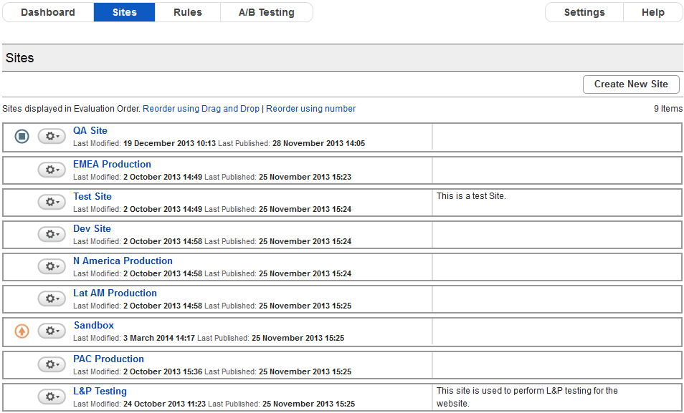




The Sites screen
These appear in multiple screens
Notes:
* Document the icons so they can be reused. Document the text areas. Create hotspots.

Slide 10
The strategy
Each .png file has a key.
Each .image element contains a .png and <alt> text
Each screen has a <properties> table.
  Each <property> in that table corresponds to a control or field on the UI.
  Each <property> will conref in an <image> if appropriate
Each screen also has a <concept> topic.
  The concept topic conrefs in the relevant property.
Each screen also has an imagemap.
  The imagemap links to the property on the concept topic.

Slide 11
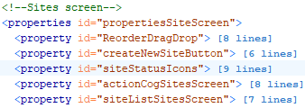
The approach
Give each graphic a key.
  <keydef keys="picture_icon_actionCog" href="actionCog.png" format="png"></keydef>
Create an <image> element for each graphic and put them all in one topic. (That way, I can reuse the <alt> text as well.)
  <image keyref="picture_icon_actionCog" id="actionCog">
  <alt>This image shows the action cog button, which is a picture of a gear with a downward-facing arrow to the right of it.</alt>
  </image>
Create a <properties> table for each screen. Each property in the table is an area of the screen.
Notes:
The little cog means different things on different windows.

Slide 12
The approach (cont)
Define each <property> in a consistent manner.
  <proptype> = Name
  < propvalue> = Description
  <propdesc> = More info. If the property contains a graphic, conref in the image.
  <property id="siteStatusIcons">
  <proptype>Site status icons</proptype>
  <propvalue>If they appear, these icons tell you something about the site.</propvalue>
  <propdesc><ul>
  <li>This icon <image conkeyref="imageList/iconEvaluationStopped"/> means that the site evaluation has been stopped.</li>
  <li>This icon <image conkeyref="imageList/iconSiteModified"/> means that the site has
  been modified since the last time it was published.</li>
  </ul></propdesc>
  </property>
Notes:
The little cog means different things on different windows.

Slide 13
The approach (cont)
Create a reference topic for each screen.
<reference id="reference_tq4_rrs_p2b">
<title>Sites screen</title>
<shortdesc>Start here to view and manage your sites.</shortdesc>
<refbody>
<section>
<p conkeyref="imageList/imagemapSiteScreen"/>
</section>
<section>
<title>Fields on the Site Screen</title>
</section>
<properties>
<prophead>
<proptypehd>What it is</proptypehd>
<propvaluehd>What it does</propvaluehd>
<propdeschd>More info</propdeschd>
</prophead>
<property id="ReorderDragDrop" conkeyref="fieldList/ReorderDragDrop"/>
<property id="createNewSiteButton" conkeyref="fieldList/createNewSiteButton"/>
<property id="siteStatusIcons" conkeyref="fieldList/siteStatusIcons"/>
<property id="actionCog" conkeyref="fieldList/actionCogSitesScreen"/>
<property id="siteNameSitesScreen" conkeyref="fieldList/siteListSitesScreen"/>
</properties>
</refbody>
</reference>
<properties> table to house my element defs
Notes:
The little cog means different things on different windows.

Slide 14
The approach (cont)
Create a reference topic for each screen. (And, of course, define a key for it.)
<reference id="reference_tq4_rrs_p2b">
<title>Sites screen</title>
<shortdesc>Start here to view and manage your sites.</shortdesc>
<refbody>
<section>
<p conkeyref="imageList/imagemapSiteScreen"/>
</section>
<section>
<title>Fields on the Site Screen</title>
</section>
<properties>
<prophead>
<proptypehd>What it is</proptypehd>
<propvaluehd>What it does</propvaluehd>
<propdeschd>More info</propdeschd>
</prophead>
<property id="ReorderDragDrop" conkeyref="fieldList/ReorderDragDrop"/>
<property id="createNewSiteButton" conkeyref="fieldList/createNewSiteButton"/>
<property id="siteStatusIcons" conkeyref="fieldList/siteStatusIcons"/>
<property id="actionCog" conkeyref="fieldList/actionCogSitesScreen"/>
<property id="siteNameSitesScreen" conkeyref="fieldList/siteListSitesScreen"/>
</properties>
</refbody>
</reference>
Each property gets an ID so I can reuse it
<properties> table to house my element defs
Notes:
The little cog means different things on different windows.

Slide 15
The approach (cont)
Create an imagemap for the screen.
  Save a picture of the screen as a .png (with a key, of course)
  Create an imagemap
  Define the hotspots
  Have them each point to the relevant <property> on the screen topic.
Notes:
The little cog means different things on different windows.

Slide 16
Imagemap (code)
the picture
<p id="imagemapSiteScreen">
<imagemap>
<image keyref="picture_screen_sites" id="sitesScreen">
<alt>This image shows the Sites screen. The screen has two columns. The left column
displays a list of sites, each of which is preceded by an gear icon and, in two cases,
a status icon. The right column displays notes about the site. At the top right there
is a Create New Site button.</alt>
</image>
<area>
<shape>rect</shape>
<coords>811, 103, 945, 131</coords>
<xref format="dita" keyref="createSite">Click this to create a new site.</xref>
</area>
<area>
<shape>rect</shape>
<coords>1, 142, 501, 158</coords>
<xref format="dita" keyref="sitesScreen/ReorderDragDrop">Choose one of these options to
change the order of the site list.</xref>
</area>
<area>
<shape>rect</shape>
<coords>7, 174, 49, 521</coords>
<xref format="dita" keyref="sitesScreen/siteStatusIcons">If you see them, these icons
provide information about the site.</xref>
</area>
<area>
<shape>rect</shape>
<coords>101, 171, 952, 531</coords>
<xref format="dita" keyref="sitesScreen/siteNameSitesScreen">This is where all the sites
are listed.</xref>
</area>
<area>
<shape>rect</shape>
<coords>53, 172, 94, 530</coords>
<xref format="dita" keyref="sitesScreen/actionCog">Click this to delete the site, start
or stop evaluation, or get the site publishing status.</xref>
</area>
</imagemap>
</p>
Link to a task
hotspots
Link to the property on the screen topic

Slide 17
Good and bad
The good news is that I get…
  A bunch of reusable chunks
  A system that can adapt to UI changes
  A system that we can use if contextual help is implemented.
The bad news is…
  This is a lot to keep track of without a CMS
  Manually enforcing naming and other standards is tough
  Testing can be difficult

Slide 18
But at least…
…everything has a key ;-).
Questions?

